Slide 1

URBAN BLOOM
Presented by: Nikhil Ramesh Hegde
Pavani Bokam
Trainer: Anil Boppuri

Slide 2
Problem Statement
Local businesses are important but often have trouble being seen, managing their tasks, and reaching customers. People miss out on great local products, and it's harder for small businesses to compete with big stores and online shopping. To help, we built an easy-to-use website that brings all local vendors and their products together, helping businesses grow, be more productive, and connect with more customers.

Slide 3
PROCESS FLOW
UrbanBloom allows users to register, log in, and update profiles. Vendors can register, manage their profiles, and add or update products. Customers browse products, read reviews, and place orders. Vendors manage orders, process them, and handle shipping. The platform also tracks order history for users and vendors, ensuring smooth transactions

Slide 4
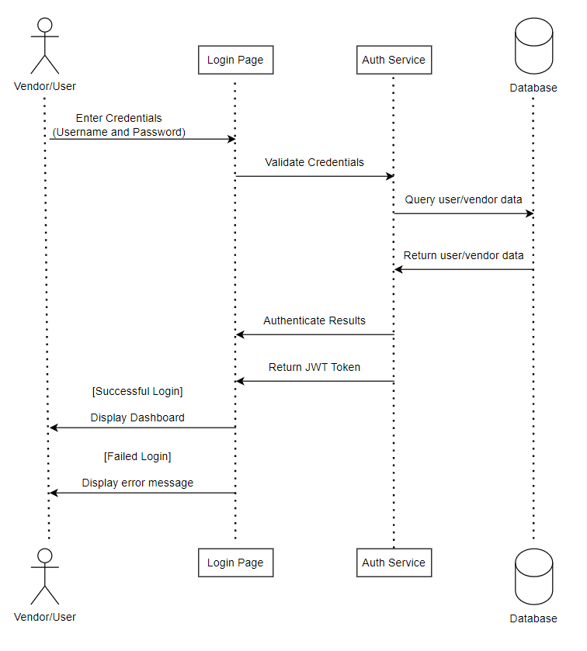
User/Vendor Login Flow Diagram

Slide 5
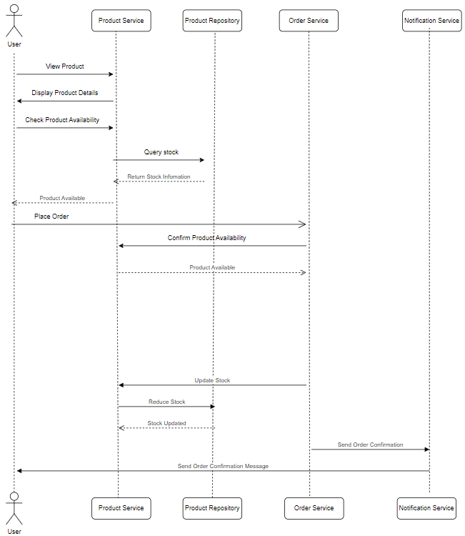
Flow Diagram for place an Order

Slide 6
PROPOSED SOLUTION
SOLUTION OVERVIEW
UrbanBloom is an online platform that helps local businesses by allowing vendors to list products and manage orders. Customers can browse products, place orders, and leave reviews. It connects vendors with more customers, streamlining business operations and improving the shopping experience.

Slide 7
PROPOSED SOLUTION
KEY FEATURES
User Management: Users can register, log in, log out, and update profiles.
Vendor Management: Vendors can register, manage profiles, view product catalog.
Product Management: Supports adding, updating, deleting, retrieving products and managing reviews.
Order Management: Allows users to place orders, view order history

Slide 8
PROPOSED SOLUTION
TECHNOLOGIES USED
Programming Language: Java 17 for backend development.
Frameworks: Spring Boot for microservices, Spring Security for secure access.
Database: MongoDB for flexible, scalable data storage.
Frontend: Angular for responsive user interfaces.
API Gateway & Service Discovery: Spring Cloud for routing and managing microservices.

Slide 9
PROPOSED SOLUTION
ADVANTAGES
Enhance the vendors productivity
Easier Management
Better Shopping Experience
Low-cost
Reach the products to the customers

Slide 10
Security Features
Security is a top priority in UrbanBloom, with features including
JWT Authentication: Tokens are used for secure login.
Role-Based Access Control: Ensures access to only permitted resources.
Data Encryption: Encrypts sensitive data in transit and at rest.
Input Validation: Validates user input to prevent injection attacks.

Slide 11
Project Management
UrbanBloom is a helpful platform that supports local businesses by making it easier for them to manage their products and reach more customers. It connects vendors and customers in a simple way, helping businesses grow and succeed. At the same time, it makes shopping local easy and convenient for customers, creating a win-win for everyone.

Slide 12
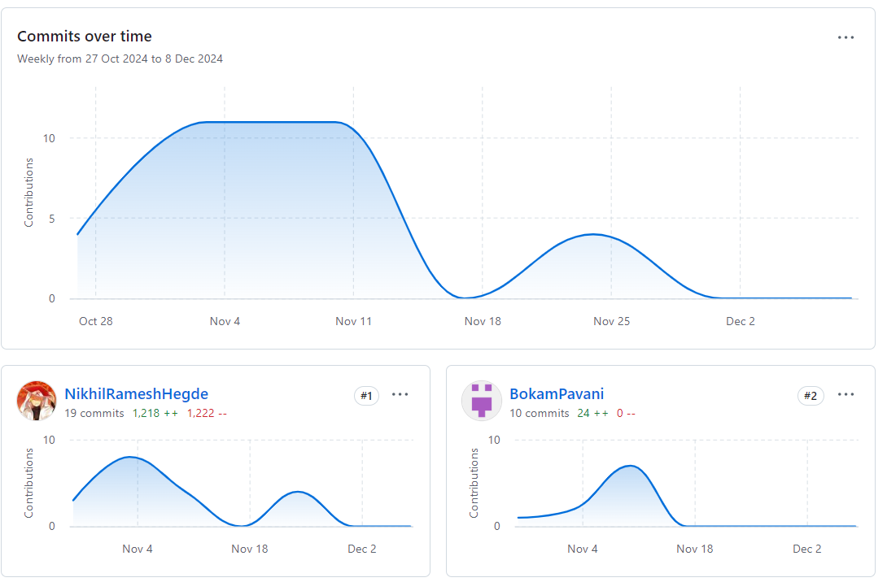
PROJECT MANAGEMENT (GITHUB COLLABORATION)

Slide 13
Conclusion
UrbanBloom is a helpful platform that supports local businesses by making it easier for them to manage their products and reach more customers. It connects vendors and customers in a simple way, helping businesses grow and succeed. At the same time, it makes shopping local easy and convenient for customers, creating a win-win for everyone.

Slide 14


